Slide 1
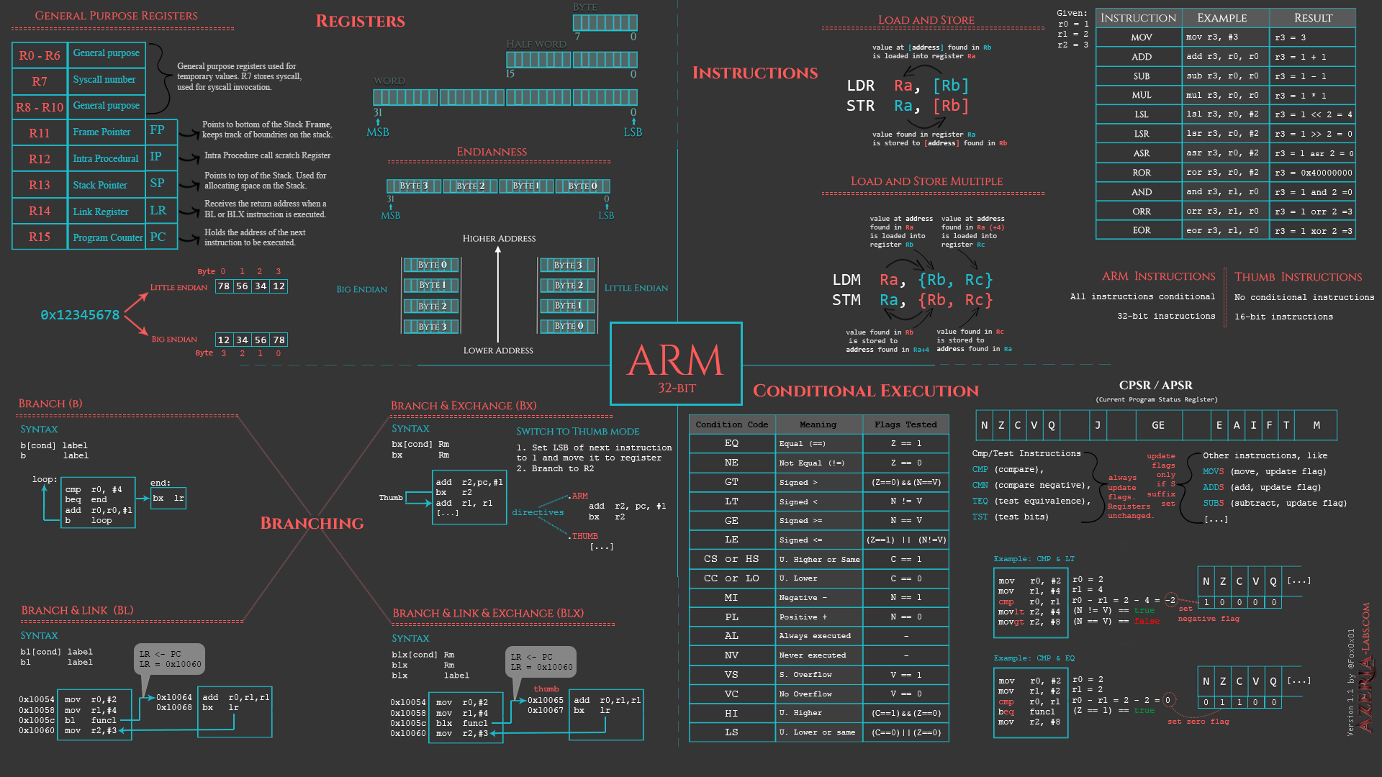
ARRAY
8086 Assembly
CSE 315 January 2022
Md. Tareq Mahmood
Department of CSE, BUET

Slide 2
Define Array
A 5 character string named MSG
MSG DB ‘abcde’
A word array W of 6 integers
W DW 10, 20, 30, 40, 50, 60
A byte array R of 100 bytes
R DB 100 DUP(?)

Slide 3
Array
W DW 10, 20, 30, 40
Address | Value | Comment
0720:0000 | 10 | 1st Element W[0]
0720:0001 | 00
0720:0002 | 20 | 2nd Element W[2]
0720:0003 | 00
0720:0004 | 30 | 3rd Element W[4]
0720:0005 | 00
0720:0006 | 40 | 4th Element W[6]
0720:0007 | 00

Slide 4
Array
W DB 10, 20, 30, 40
Address | Value | Comment
0720:0000 | 10 | 1st Element W[0]
0720:0001 | 20 | 2nd Element W[1]
0720:0002 | 30 | 3rd Element W[2]
0720:0003 | 40 | 4th Element W[3]
0720:0004
0720:0005
0720:0006
0720:0007

Slide 5
DUP operator
repeat_count DUP (value)
An array of 100 words, each initialized to 0
GAMMA DW 100 DUP (0)
An array of 212 uninitialized bytes.
DELTA DB 212 DUP (?)
Nested DUP operator
LINE DB 5, 4, 3 DUP (2, 3 DUP (0), 1)
is equivalent to
LINE DB 5, 4, 2, 0, 0, 0, 1, 2, 0, 0, 0, 1, 2, 0, 0, 0, 1

Slide 6
How to Access Array Elements
Register indirect mode
Based and Indexed mode
Based indexed mode (2D Array)

Slide 7
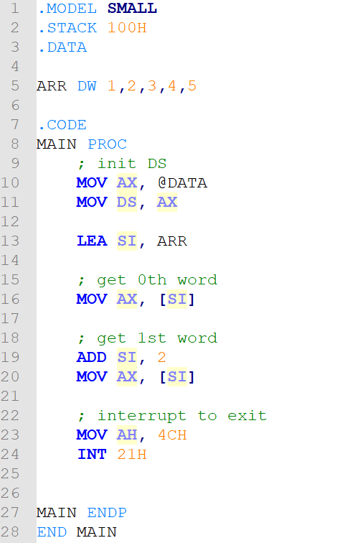
Register indirect mode
[register]
Register can be BX, SI, DI.

Slide 8
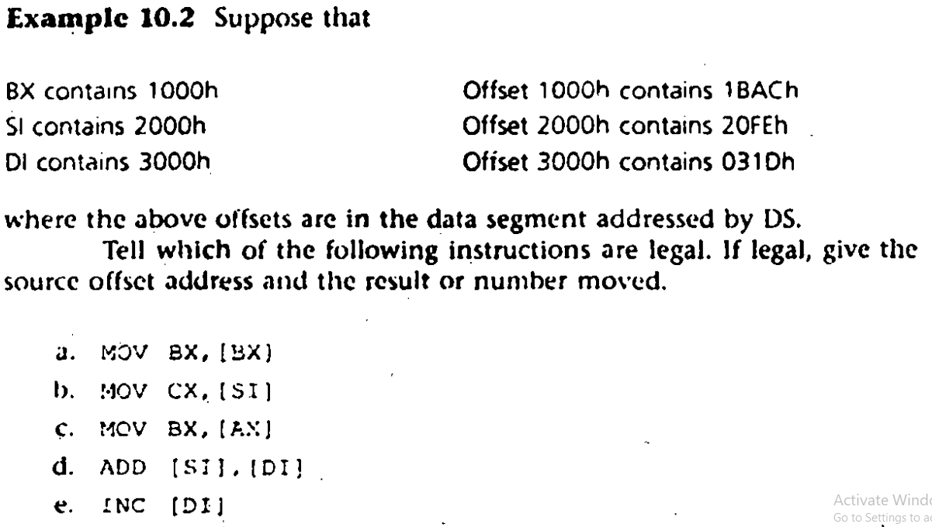
Practice

Slide 9
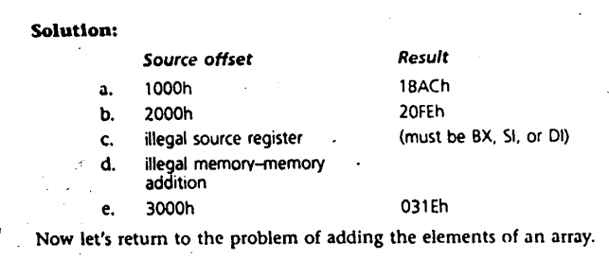
Solution

Slide 10
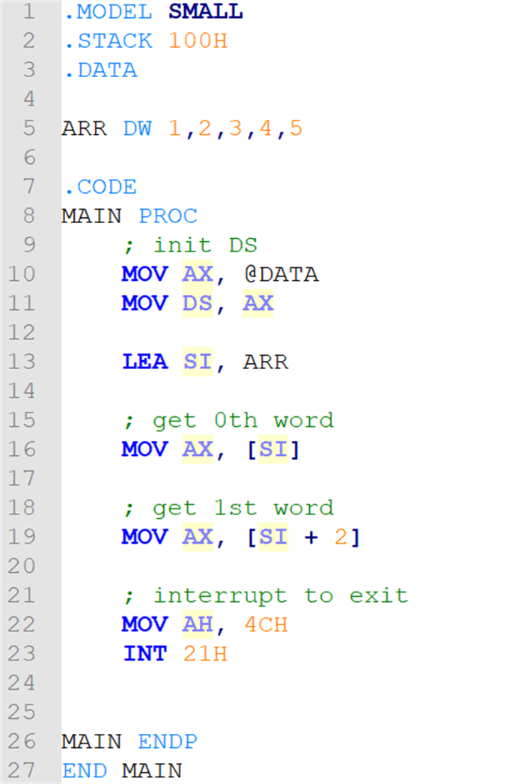
Based & Indexed mode
[register + displacement]
[displacement + register]
[register] + displacement
displacement + [register]
displacement[register]
Register can be BX, SI, DI.

Slide 11
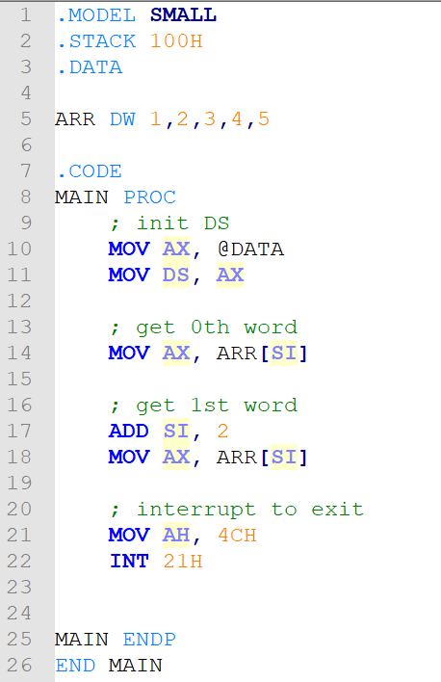
Based & Indexed mode
[register + displacement]
[displacement + register]
[register] + displacement
displacement + [register]
displacement[register]
Register can be BX, SI, DI.

Slide 12
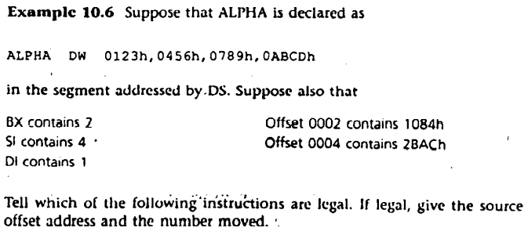
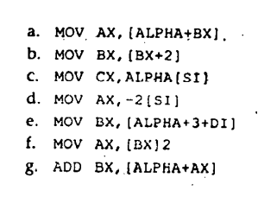
Practice

Slide 13
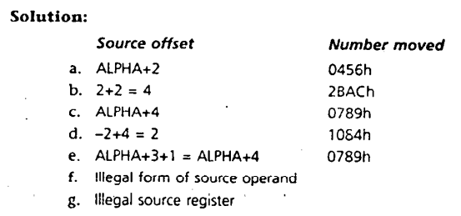
Solution

Slide 14
PTR operator
Instructions such as
MOV [BX], 1 ; illegal
the destination is byte or word is unknown
The PTR operator can be used for type casting
MOV BYTE PTR [BX], 1
MOV WORD PTR [BX], 1

Slide 15
References
Chapter 10

